Slide 1
Course Code: CSC211A Course Title: Formal Languages and Automata Theory
Lecture 25: Applications of regular Closure-1
Course Leader:
Prakash P
prakashp.cs.et@msruas.ac.in

Slide 2
Session Objectives
At the end of this session, student will be able
Explain applications of regular closure
Understand decidable properties of context-free languages
Describe the pumping lemma for context-free languages

Slide 3
Session Topics
Applications of regular closure
Decidable properties of context-free languages
Pumping lemma for context-free languages

Slide 4
Applications of Regular Closure
The intersection of a context-free language and a regular language is a context-free language
Regular Closure
context free
regular
context-free

Slide 5
An Application of Regular Closure
Prove that:
is context-free
We know:
is context-free

Slide 6
An Application of Regular Closure
We also know:
is regular
is regular

Slide 7
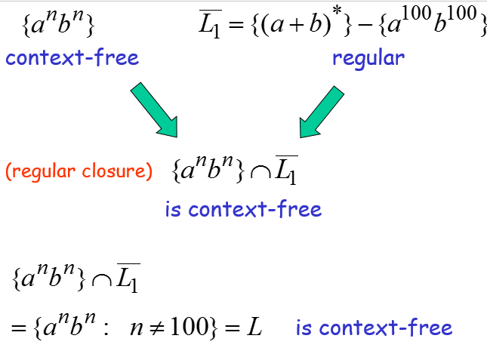
An Application of Regular Closure

Slide 8
Another Application of Regular Closure
Prove that:
is not context-free

Slide 9
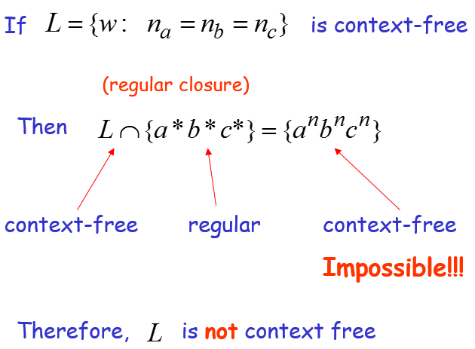
An Application of Regular Closure

Slide 10
Decidable Properties of Context-Free Languages

Slide 11
Decidable Properties of CFL
Membership Question:
for context-free grammar
find if string
Membership Algorithms:
Parsers
Exhaustive search parser
CYK parsing algorithm

Slide 12
Decidable Properties of CFL
Empty Language Question:
for context-free grammar
find if
Algorithm:
Remove useless variables
Check if start variable is useless

Slide 13
Decidable Properties of CFL
Infinite Language Question:
for context-free grammar find if is infinite
Algorithm:
1. Remove useless variables
2. Remove unit and productions
3. Create dependency graph for variables
4. If there is a loop in the dependency graph
then the language is infinite

Slide 14
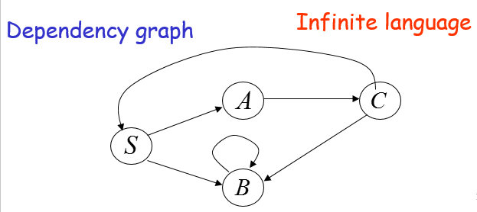
Example

Slide 15
Example

Slide 16
The Pumping Lemma for Context-Free Languages

Slide 17
Pumping Lemma for CFL
Take an infinite context-free language
Generates an infinite number of different strings
Example:

Slide 18
Pumping Lemma for CFL
A derivation:
Variables are repeated

Slide 19
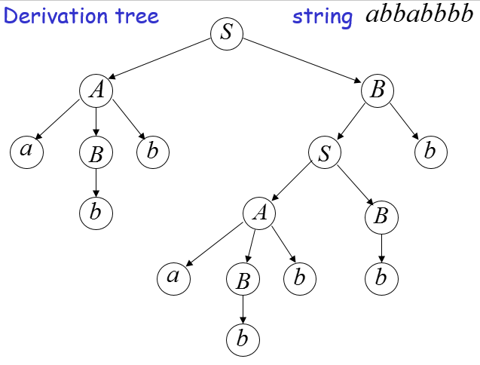
Pumping Lemma for CFL

Slide 20
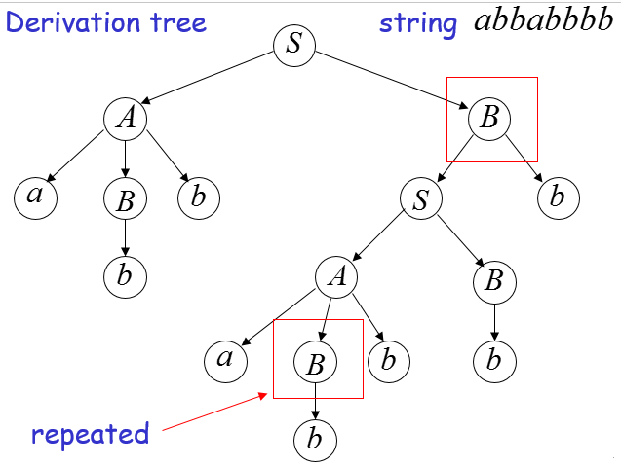
Pumping Lemma for CFL

Slide 21
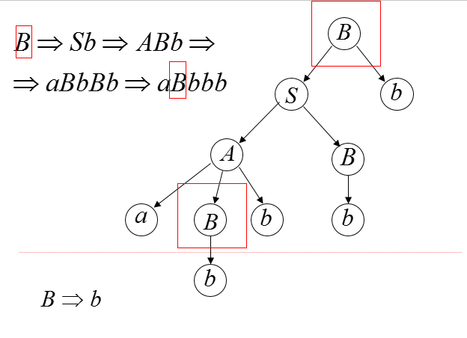
Pumping Lemma for CFL

Slide 22
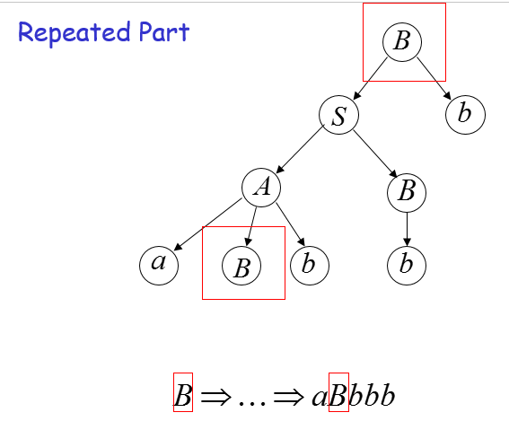
Pumping Lemma for CFL

Slide 23
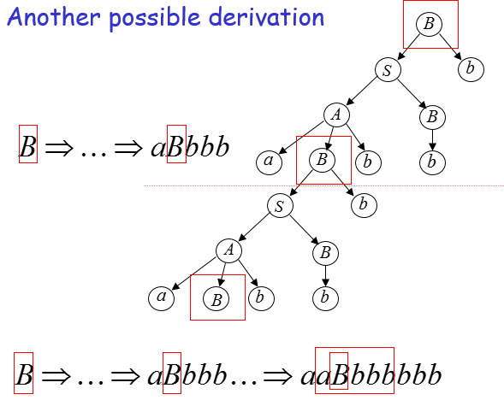
Pumping Lemma for CFL

Slide 24
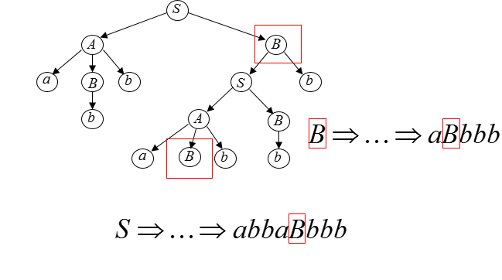
Pumping Lemma for CFL

Slide 25
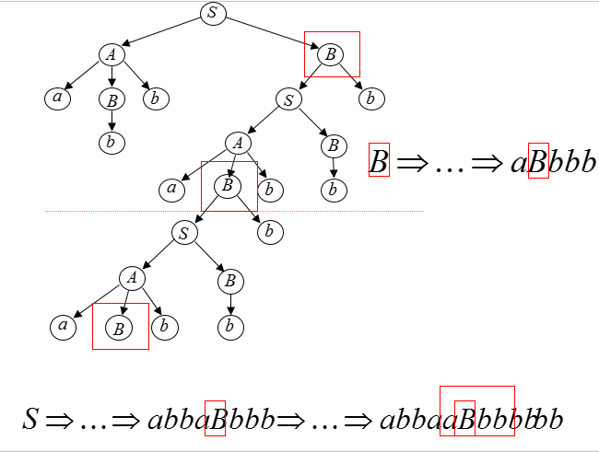
Pumping Lemma for CFL

Slide 26
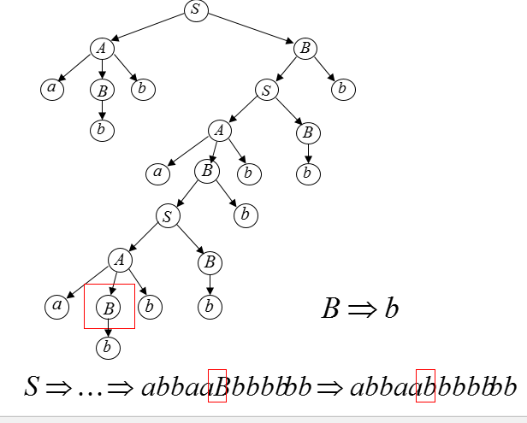
Pumping Lemma for CFL

Slide 27
Pumping Lemma for CFL
Therefore, the string
is also generated by the grammar

Slide 28
Pumping Lemma for CFL
We know:
We also know this string is generated:

Slide 29
Pumping Lemma for CFL
We know:
Therefore, this string is also generated:

Slide 30
Pumping Lemma for CFL
We know:
Therefore, this string is also generated:

Slide 31
Pumping Lemma for CFL
We know:
Therefore, this string is also generated:

Slide 32
Pumping Lemma for CFL
Therefore, knowing that
is generated by grammar , we also know that
is generated by

Slide 33
In General
We are given an infinite context-free grammar
Assume has no unit-productions no -productions

Slide 34
Pumping Lemma for CFL
Take a string with length bigger than
>
(Number of productions) x
(Largest right side of a production)
Consequence:
Some variable must be repeated in the derivation of

Slide 35
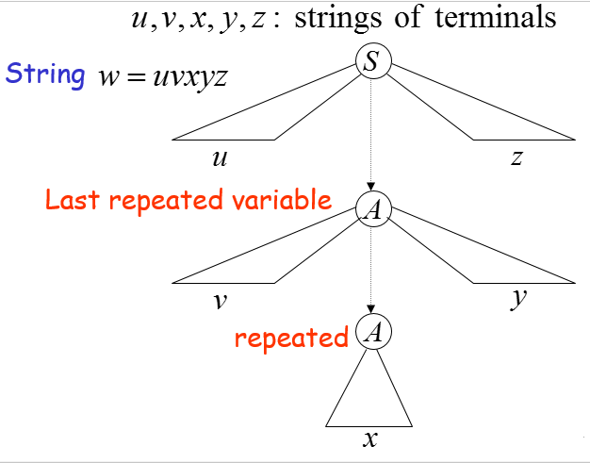
Pumping Lemma for CFL

Slide 36
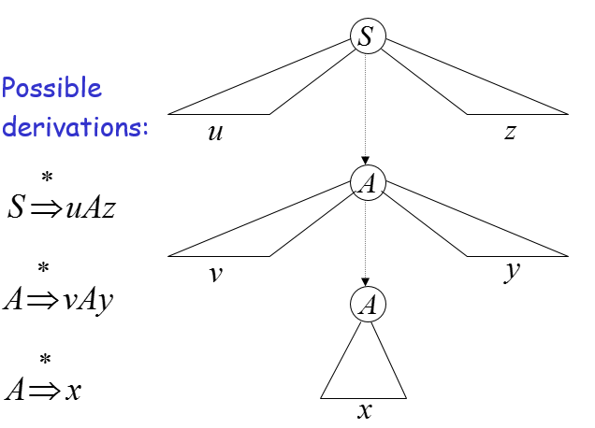
Pumping Lemma for CFL

Slide 37
Pumping Lemma for CFL
We know:
This string is also generated:

Slide 38
Pumping Lemma for CFL
We know:
This string is also generated:
The original

Slide 39
Pumping Lemma for CFL
We know:
This string is also generated:

Slide 40
Pumping Lemma for CFL
We know:
This string is also generated:

Slide 41
Pumping Lemma for CFL
We know:
This string is also generated:

Slide 42
Pumping Lemma for CFL
Therefore, any string of the form
is generated by the grammar

Slide 43
Pumping Lemma for CFL
Therefore,
knowing that
we also know that

Slide 44
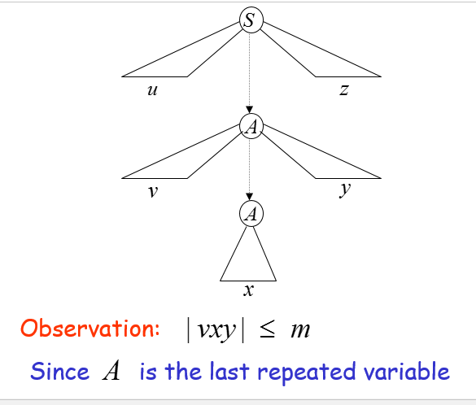
Pumping Lemma for CFL

Slide 45
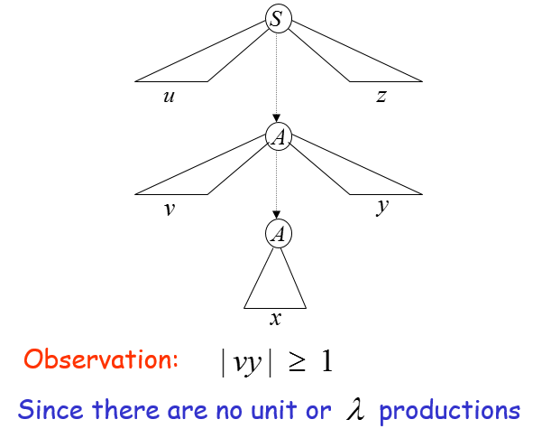
Pumping Lemma for CFL

Slide 46
The Pumping Lemma
For infinite context-free language
there exists an integer such that
for any string
we can write
with lengths
and it must be:

Slide 47
Summary
The intersection of a context-free language and a regular language is a context-free language
An infinite language generates infinite number of strings

